Slide 1
The Rady School of Management
Lecture #8
Case Study #2 – Starbucks in Milan Wrap Up
Marketing Research: Insights to Action
Super Bowl Ads!
February 3rd, 2020
MGT103 M, W – 11:00 a.m. to 12:20 p.m.

Slide 2
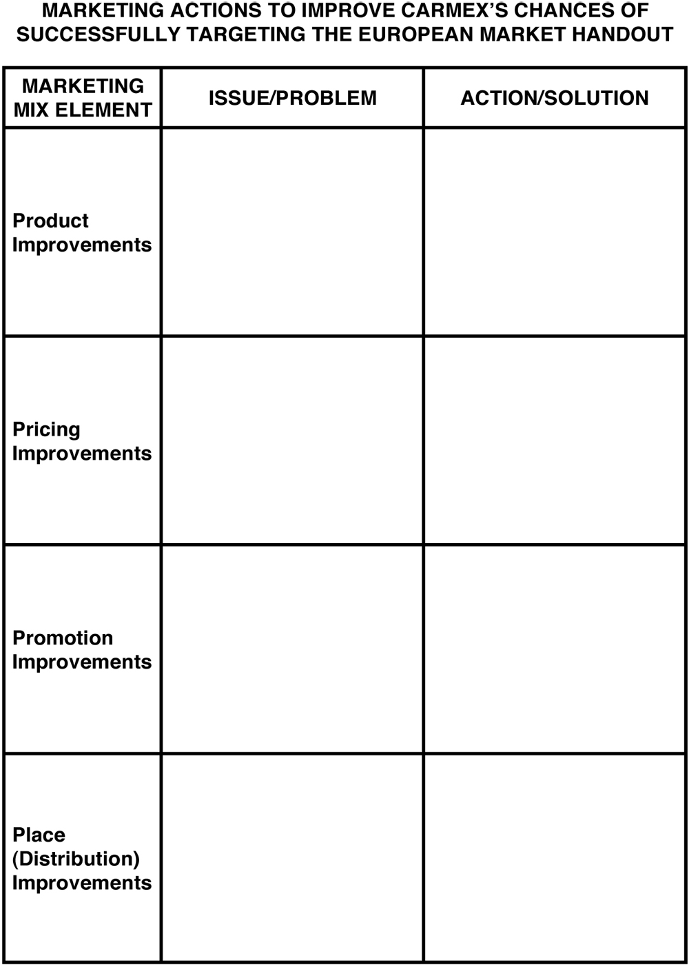
Carmex Handout.
Starbucks in Milan – Wrap up

Slide 3
Key Talking Points…….
Identify the reason for conducting marketing research.
Describe the five-step marketing research approach that leads to marketing actions.
Explain how marketing uses secondary and primary data.

Slide 4
Key Talking Points…….
The uses of observations, questionnaires, panels, experiments, and newer data collection methods.
Explain how data analytics and data mining lead to marketing actions.
Describe three approaches to developing a company’s sales forecast.

Slide 5


HOLLYWOOD LOVES MARKETING RESEARCH!
A Film Industry Secret: Research
Movie Title Testing
Concept Testing & Script Assessment
Test Screening
Tracking Studies
Social Listening

Slide 6

TOP GUN 2 TRAILER

Slide 7
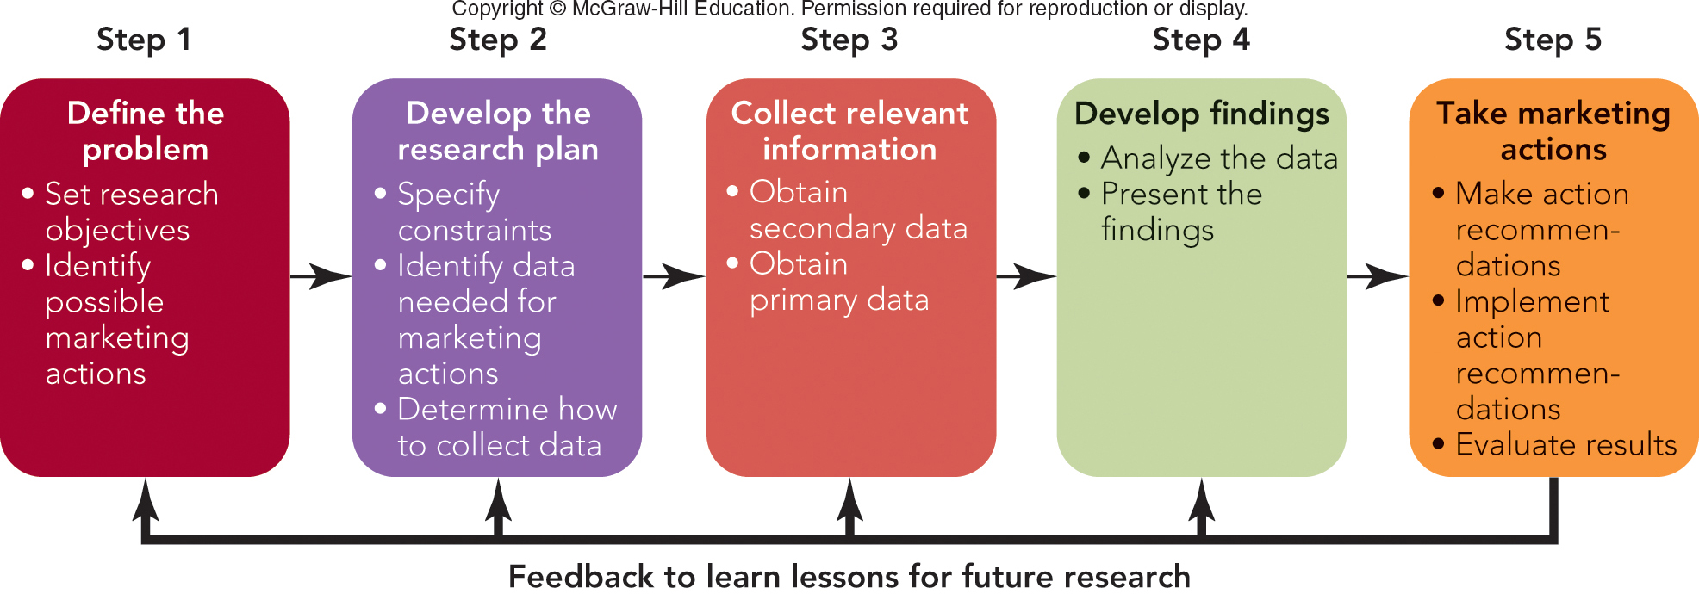
FIGURE 8-1 Five-step marketing research approach leading to marketing actions

Slide 8
STEP 1: DEFINE THE PROBLEM SET THE RESEARCH OBJECTIVES (1 of 2)
Set the Research Objectives
Have a Clear Research Purpose
Types of Marketing Research:
Exploratory
Descriptive
Causal
Identify Possible Marketing Action

Slide 9
STEP 1: DEFINE THE PROBLEM SET THE RESEARCH OBJECTIVES (2 of 2)
Measures of Success
Measure of Success: Playtime
Children Spend More Time Playing with New Design
Possible Marketing Actions
Introduce New Design
Drop Old Design

Slide 10
STEP 2: DEVELOP THE RESEARCH PLAN DETERMINE HOW TO COLLECT DATA
Constraints
Identify Data Needed for Marketing Actions
Identify Data Needed
Determine How to Collect Data
Concepts – Ideas about Products
Methods – Approaches to Collect Data

Slide 11
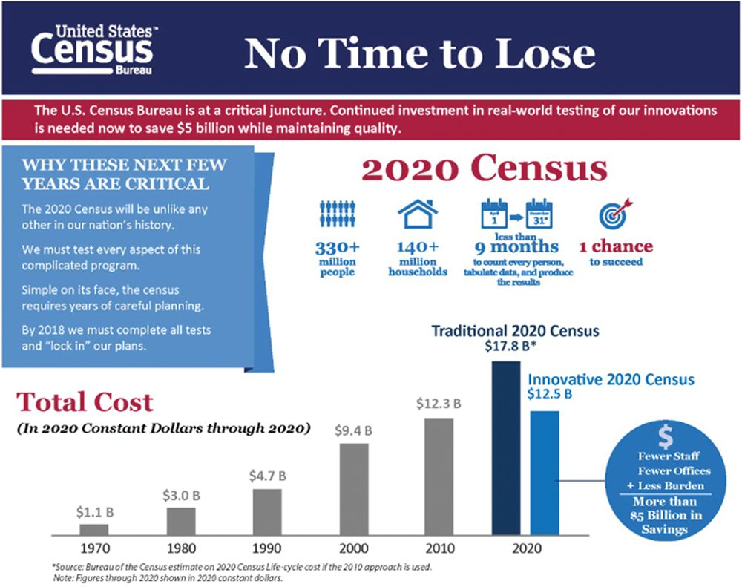
STEP 3: COLLECT RELEVANT INFORMATION
Relevant Information for Rational, Informed Marketing Decision
Data
Secondary Data
Primary Data
Source: U.S. Department of Commerce

Slide 12
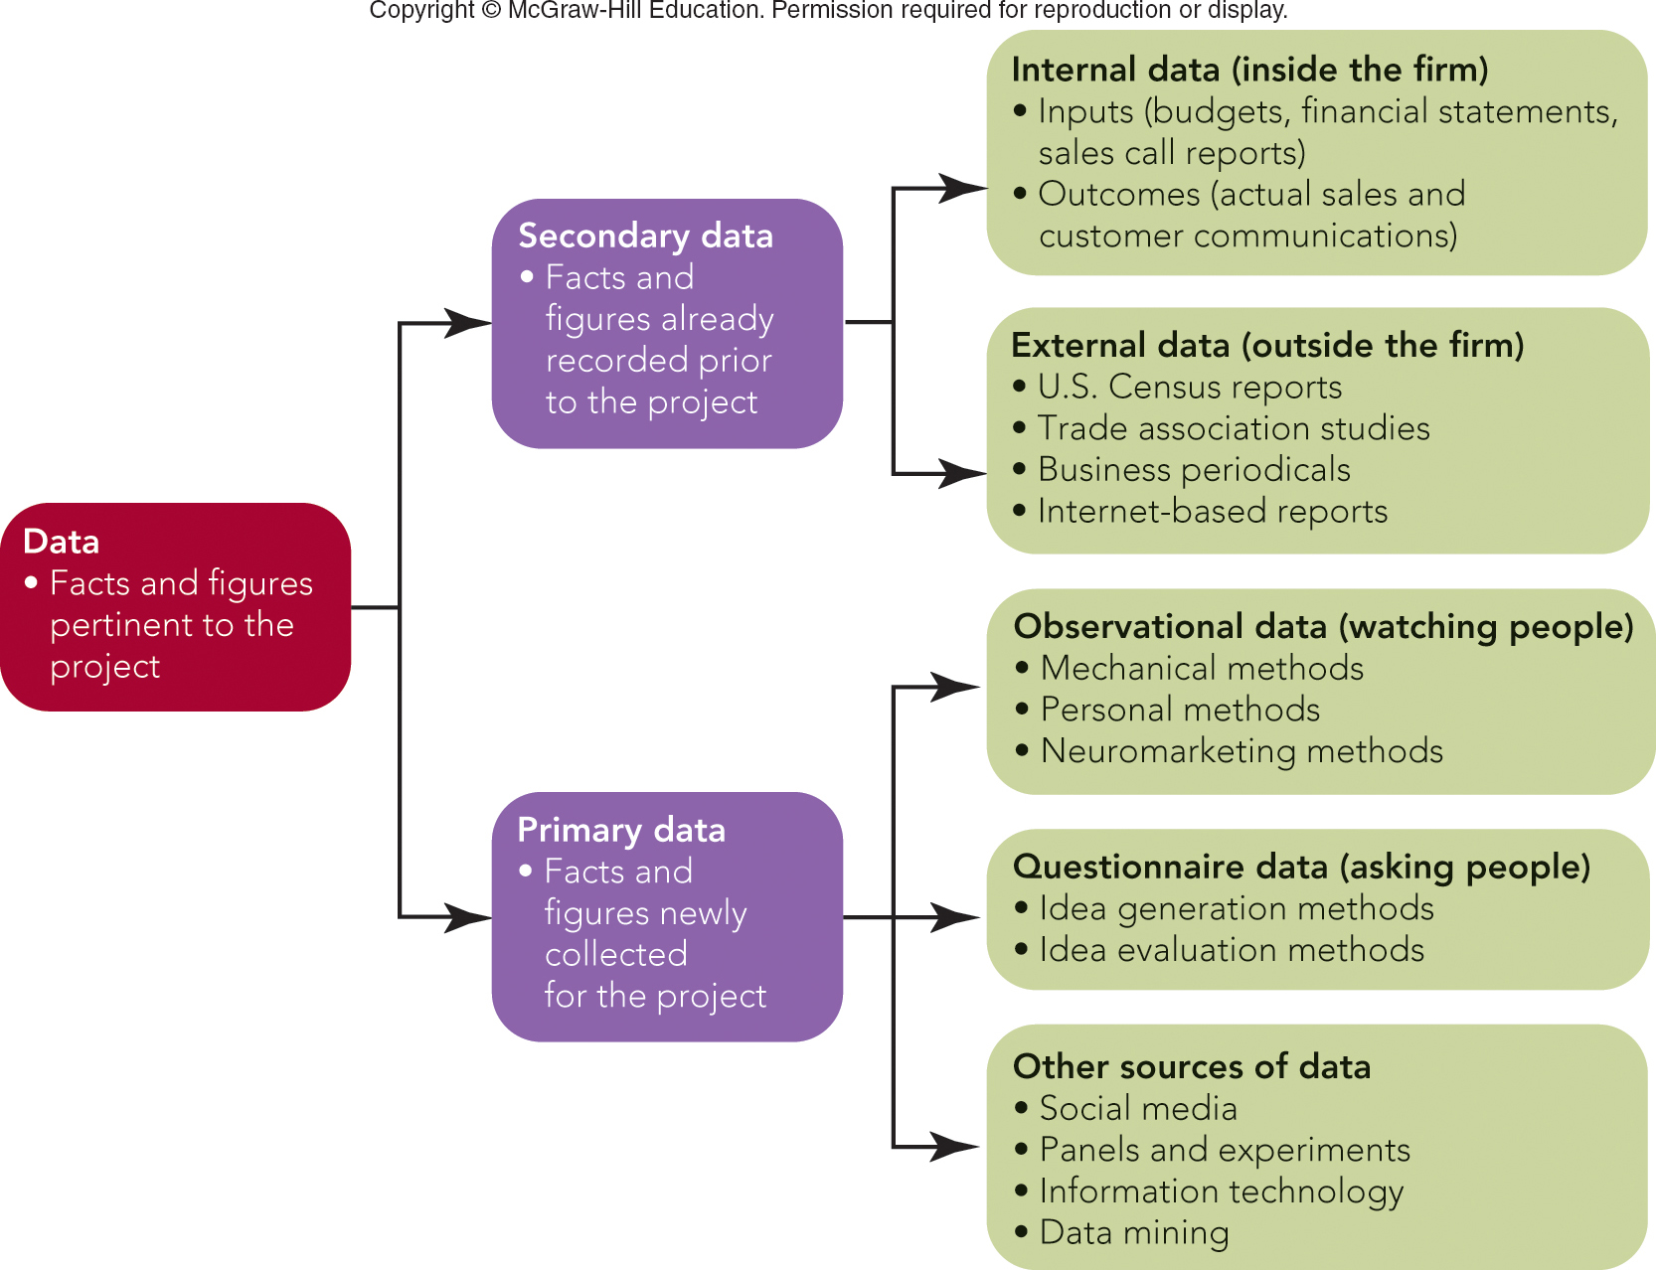
FIGURE 8-2 Types of marketing information
Jump to Appendix 2 long image description

Slide 13
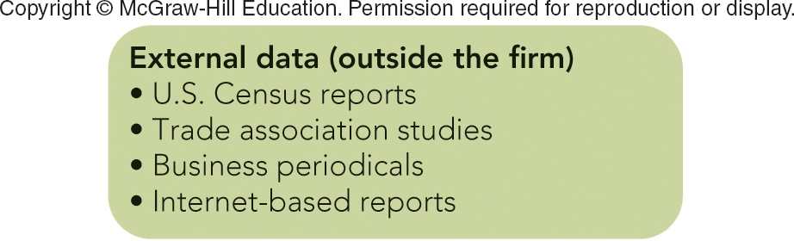
SECONDARY DATA SOURCES Online Databases and Internet Resources for Marketers
Sources of News and Articles:
LexisNexis --
CNBC --
Wall Street Journal --
Fox Business --
Sources of Statistical and Financial Data:
FedStats --
Census Bureau --
Portals and Search Engines:
USA.gov --
Google –

Slide 14
STEP 3: COLLECT RELEVANT DATA SECONDARY DATA (5 of 5)
Advantages:
Time Savings
Inexpensive
Disadvantages:
Out of Date
Definitions/Categories Not Right
Not Specific Enough

Slide 15
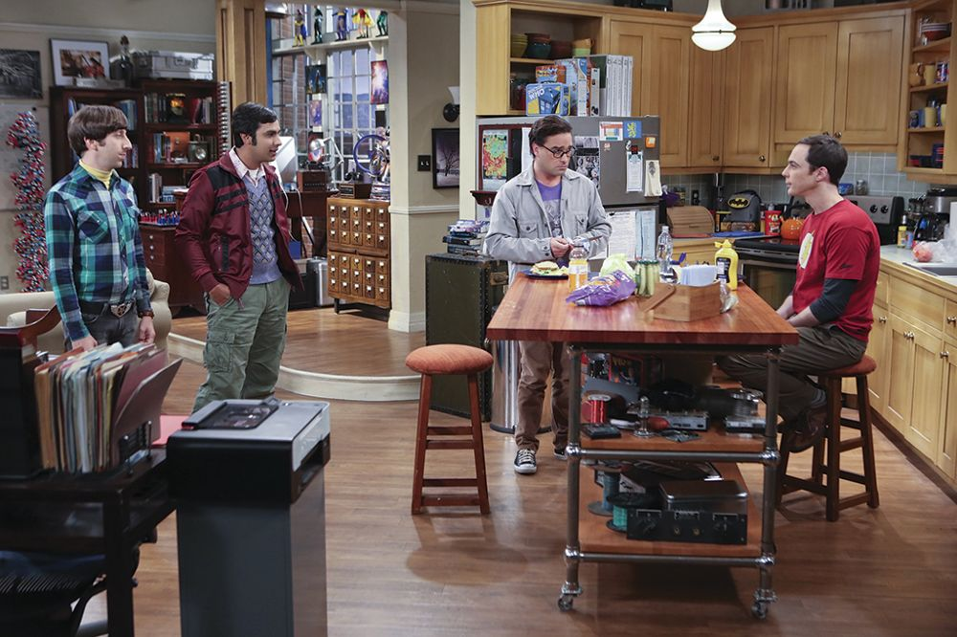
STEP 3: COLLECT RELEVANT DATA PRIMARY DATA—WATCHING PEOPLE (1 of 2)
Observational Data
Mechanical Methods
Nielsen’s People Meter
Nielsen’s TV Ratings
©CBS/Photofest

Slide 16

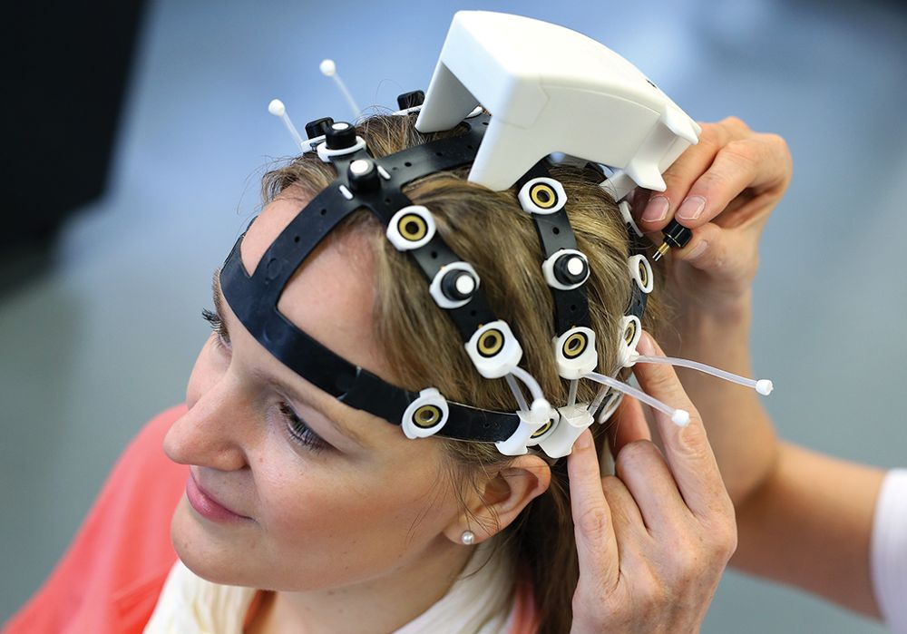
STEP 3: COLLECT RELEVANT DATA PRIMARY DATA—WATCHING PEOPLE (2 of 2)
Personal Methods:
Mystery Shopper
Observation
Ethnographic Research
Neuromarketing Methods
Technologies Used to Study the Brain
Top: ©Editorial Image, LLC; Bottom: ©Ronny Hartmann/picture-alliance/dpa/AP Images

Slide 17
STEP 3: COLLECT RELEVANT DATA PRIMARY DATA—ASKING PEOPLE (1 of 3)
Questionnaire Data
Idea Generation Methods – Coming Up with Ideas
Individual Interviews
In-Depth Interviews

Slide 18
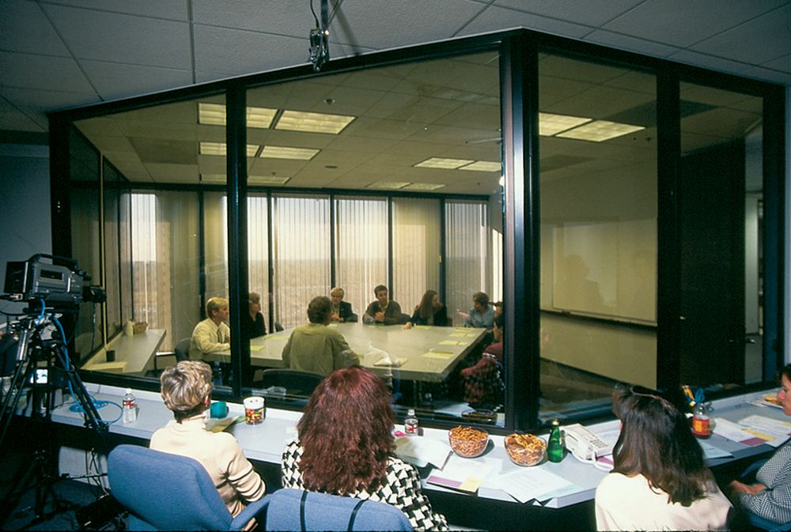

STEP 3: COLLECT RELEVANT DATA PRIMARY DATA—ASKING PEOPLE (2 of 3)
Idea Generation Methods – Coming Up with Ideas
Focus Groups
Informal Session of Customers Who Are Asked for Opinions
“The Next Big Thing”
Trend Hunting
Trend Hunter
3:15 top ten
©Spencer Grant/PhotoEdit

Slide 19
STEP 3: COLLECT RELEVANT DATA PRIMARY DATA—ASKING PEOPLE (3 of 3)
Idea Evaluation Methods – Testing an Idea:
Personal Interview Surveys
Telephone Interviews
Mail Surveys
Online (E-Mail/Internet) Surveys
Mall Intercept Interview Surveys

Slide 20
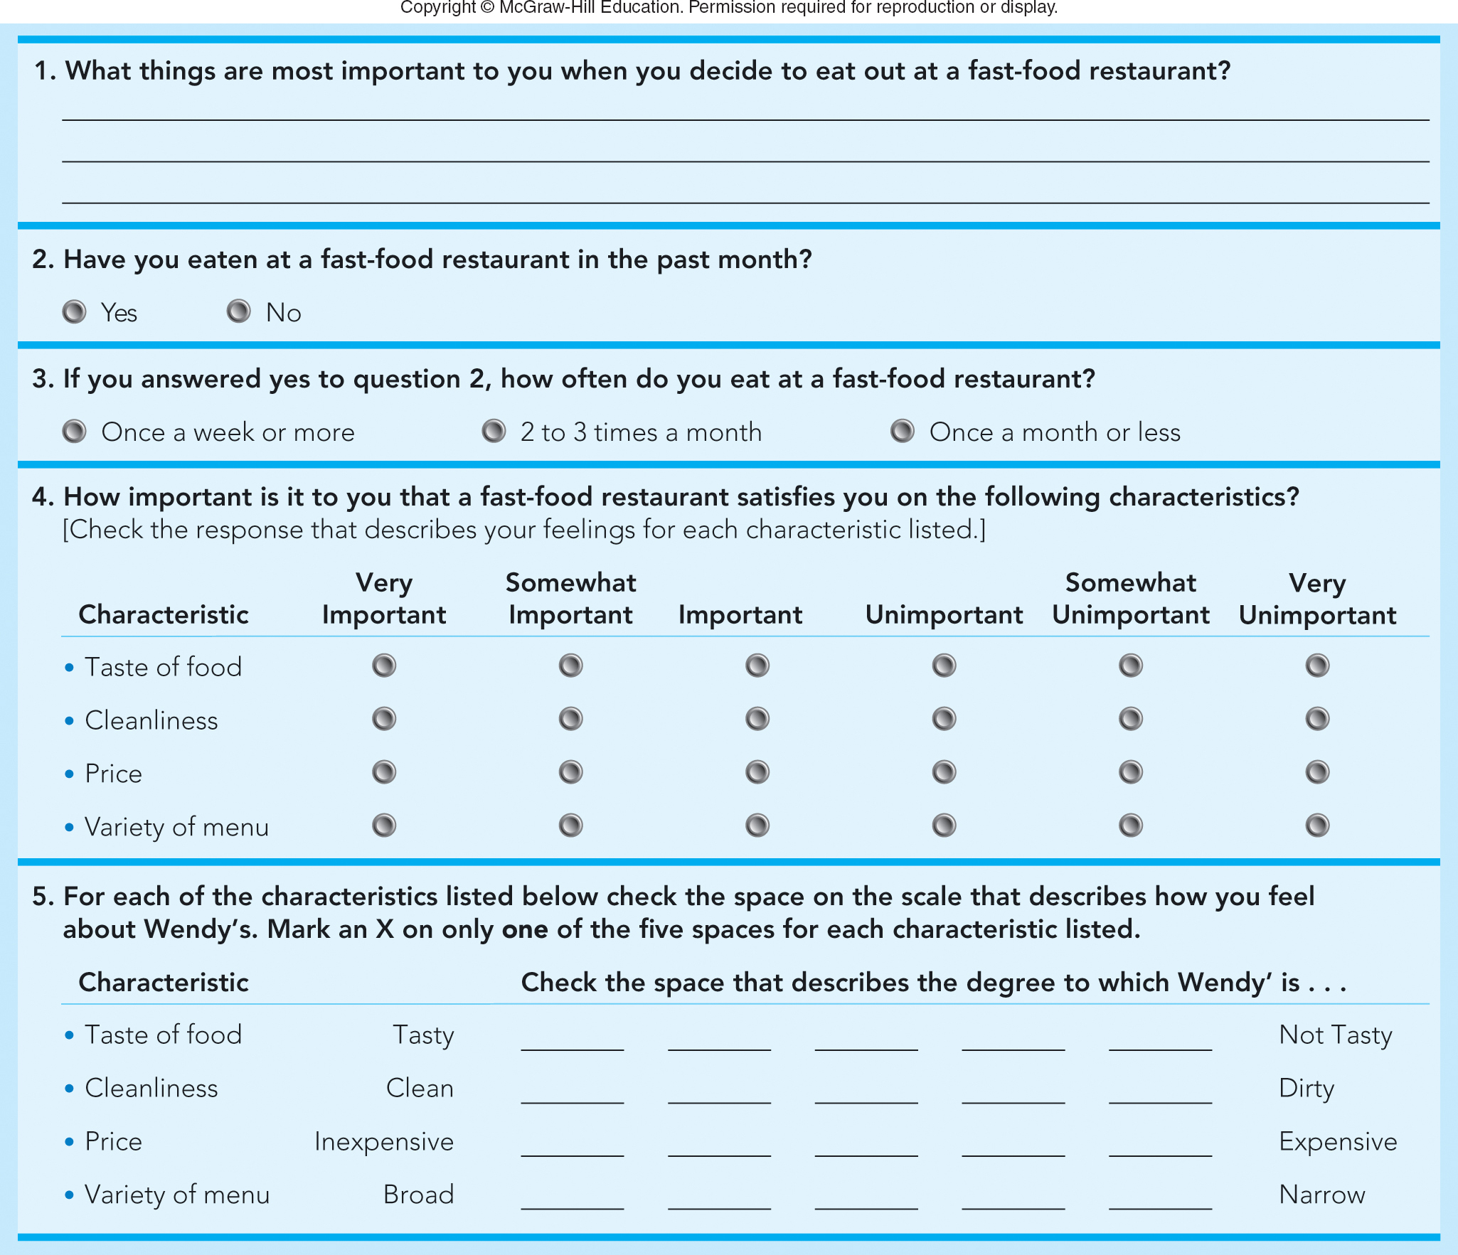
FIGURE 8-4 Different types of questions in a sample Wendy’s survey (Q1 – Q5)
Open ended
Closed ended
Dichotmous
Semantic
Differential
Likert Scale
Jump to Appendix 5 long image description

Slide 21
STEP 3: COLLECT RELEVANT DATA PRIMARY DATA—OTHER SOURCES (1 of 2)
Primary Data – Other Sources:
Social Media Can Provide Ideas for New Products and Services
Use Social Media Listening Tools

Slide 22
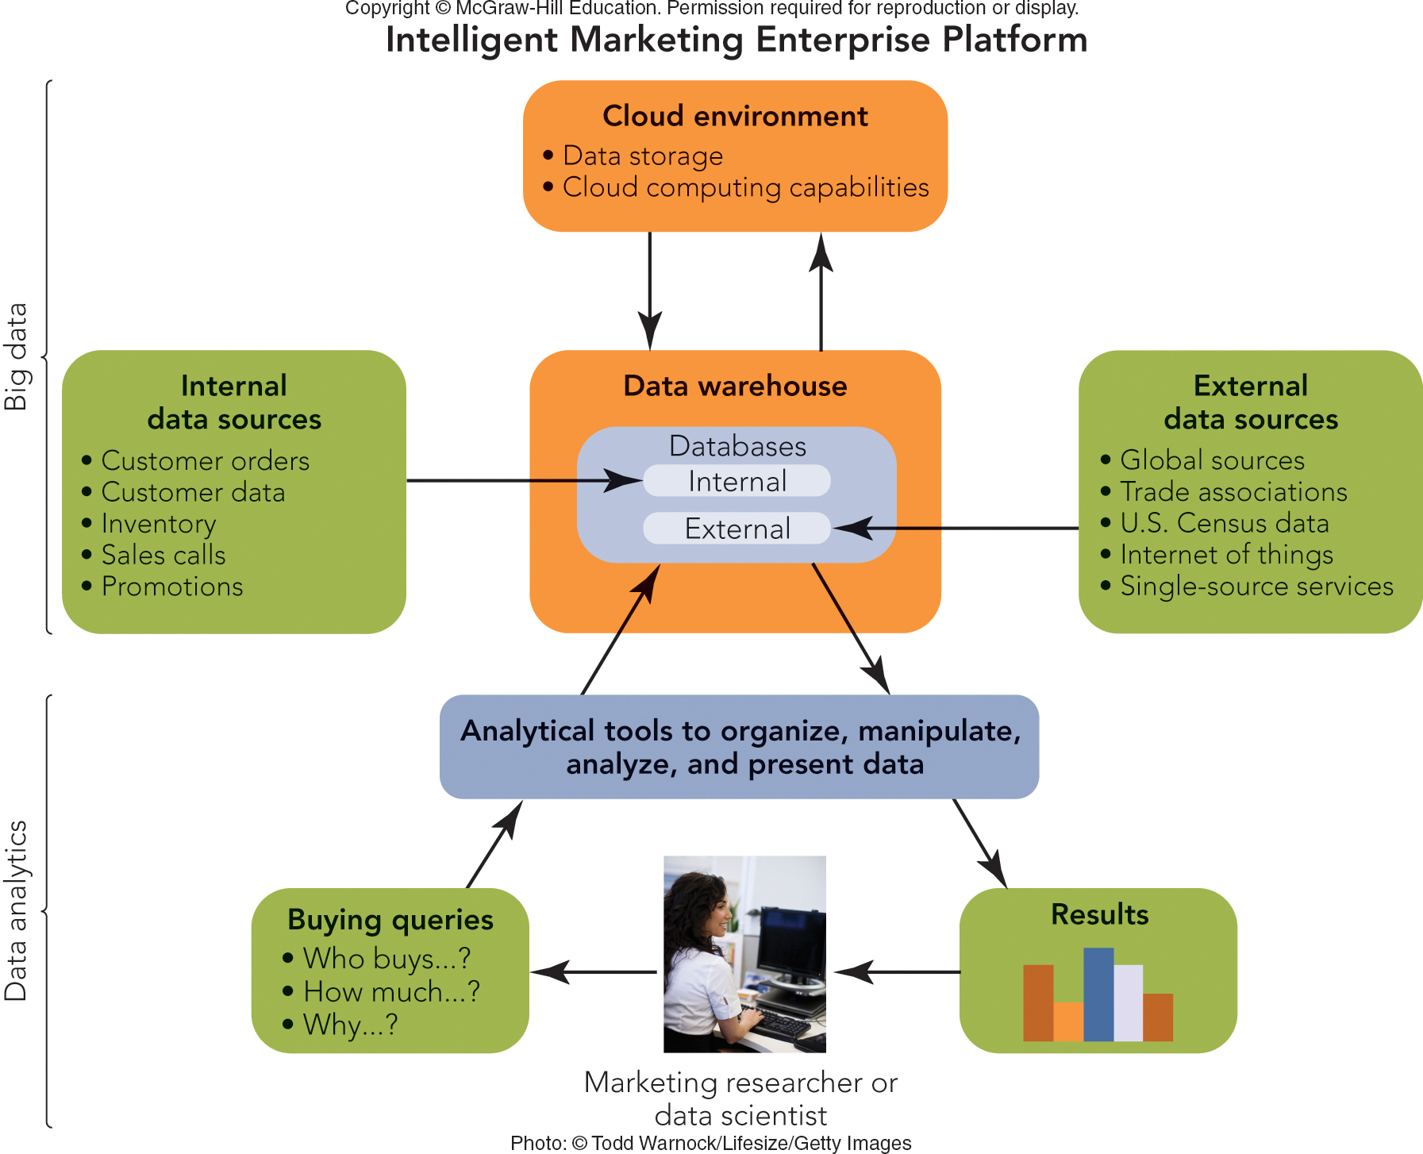
FIGURE 8-5 How marketing researchers and managers use information technology to turn information into action

Slide 23
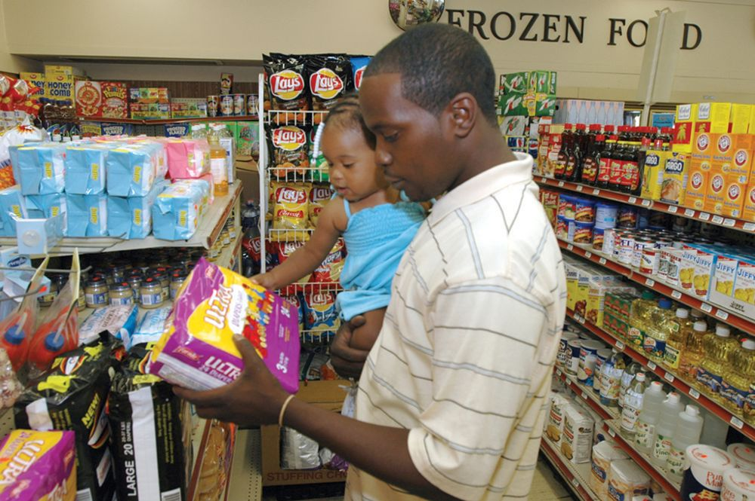
MAKING RESPONSIBLE DECISIONS NO MORE PERSONAL SECRETS: THE DOWNSIDE OF DATA MINING
Data Mining Reveals Personal Information
Collected via Tracking Devices
(Examples: Cookies and Apps)
Enables Personalization and Targeting
©Brent Jones

Slide 24
STEP 3: COLLECT RELEVANT DATA ADVANTAGES/DISADVANTAGES OF PRIMARY DATA
Advantages of Primary Data:
More Flexible
More Specific to the Problem
Disadvantages of Primary Data:
Expensive
Time Consuming to Collect

Slide 25
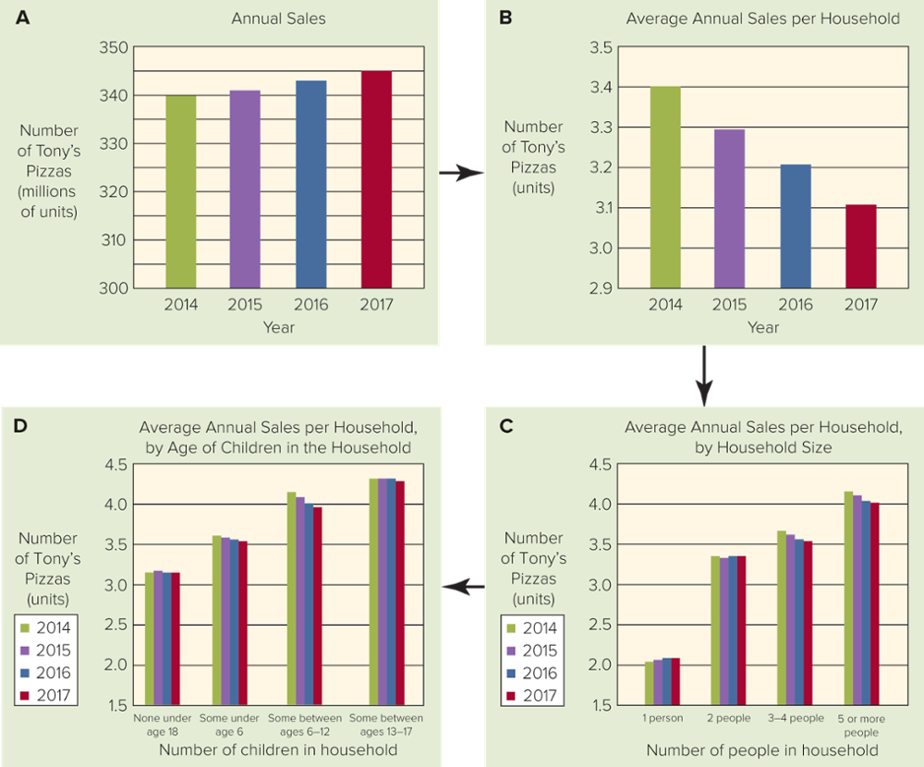
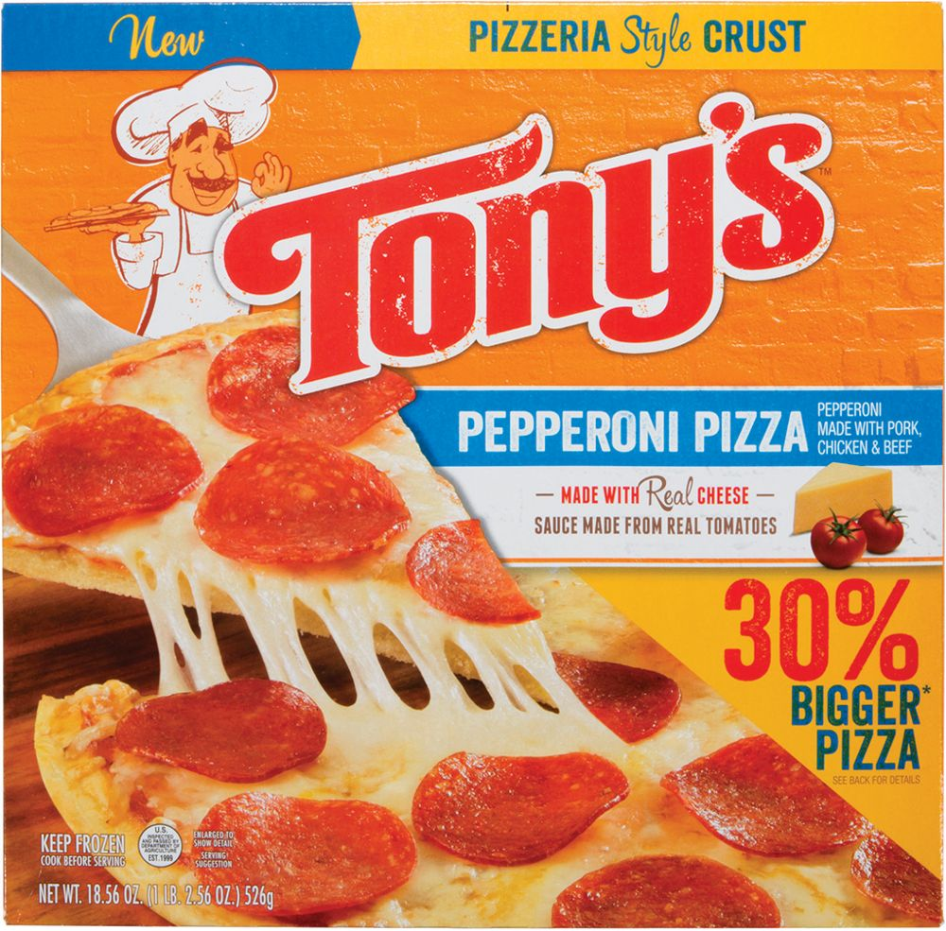
Marketing dashboards that present findings to Tony’s marketing manager that lead to recommendations and actions.
STEP 4: DEVELOP FINDINGS

Slide 26
STEP 5: TAKE MARKETING ACTIONS
Make Action Recommendations
Implement the Action Recommendations
Evaluate the Results
Evaluate the Decision Itself
Evaluate the Decision Process Used

Slide 27
SALES FORECASTING TECHNIQUES
Judgments of the Decision Maker:
Direct Forecast – best guess; used for new products
Lost-Horse Forecast – “where did we leave off?”
Surveys of Knowledgeable Groups:
Survey of Buyers’ Intentions Forecast
Salesforce Survey Forecast
3. Statistical Methods:
Trend Extrapolation: Extending a Pattern Observed in Past Data into the Future
Linear Trend Extrapolation: When the Pattern Is Described with a Straight Line

Slide 28
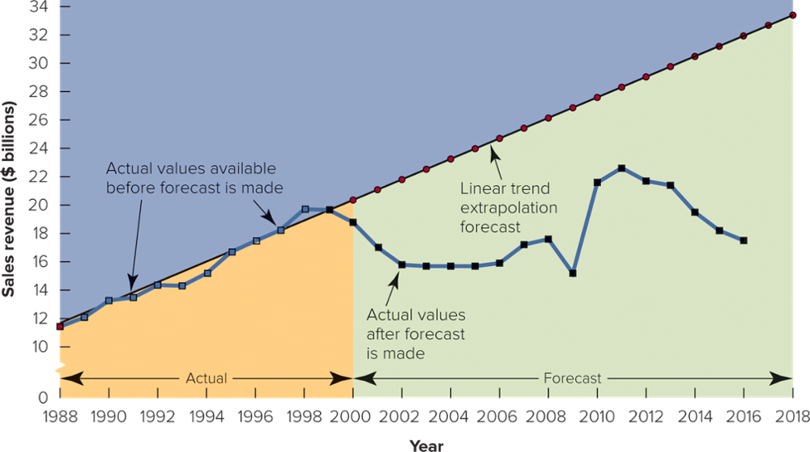
FIGURE 8-8 Linear trend extrapolation of sales revenues at Xerox, made at the start of 2000 Copyright © McGraw-Hill Education. Permission required for reproduction or display.

Slide 29
The Super Bowl!
Largest single audience opportunity of the year in
the U.S.
98.2 M U.S. viewers in 2019
Broadcasted in 30 languages to 130 countries
2020 ad cost estimate…..$5.6 M for 30 second ad!
https://www.youtube.com/watch?v=9OpuHa2vwdk
https://www.youtube.com/watch?v=lbkafMhmvMo
https://www.youtube.com/watch?v=Cdpf1Dl5b_4
https://www.youtube.com/watch?v=RF9t2rFmTVE
https://www.youtube.com/watch?v=AnhzGUcENWo
https://www.youtube.com/watch?v=CvUDuu58zbo
https://www.youtube.com/watch?v=g2ERWFMLptw
Doritos
NFL 100
Cheetos
Amazon
Jeep
P&G
Rocket

Slide 30
Announcements & Wednesday Assignment
Homework
Read Chapter #9
Group Assignment - Business Plan Project. Be thinking about your “start-up” company idea
Office Hours Today - 1:30 – 2:30 p.m. 2E108 Rady Undergrad
Rady Labs……complete ASAP, don’t delay!

Slide 31
The Rady School of Management
Lecture #8
Case Study #2 – Starbucks in Milan Wrap Up
Marketing Research: Insights to Action
Super Bowl Ads!
February 3rd, 2020
MGT103 M, W – 11:00 a.m. to 12:20 p.m.

